Slide 1

Facial Emotion & Behavior Detection using Deep Learning (GUI – Based)
School of C&IT

Slide 2
Facial Emotion & Behavior Detection using Deep Learning (GUI – Based)
Major Project Presentation

Slide 3
AGENDA
Methodology
Modules identified
Implementation
Report preparation & submission
Draft Patent/Paper

Slide 4
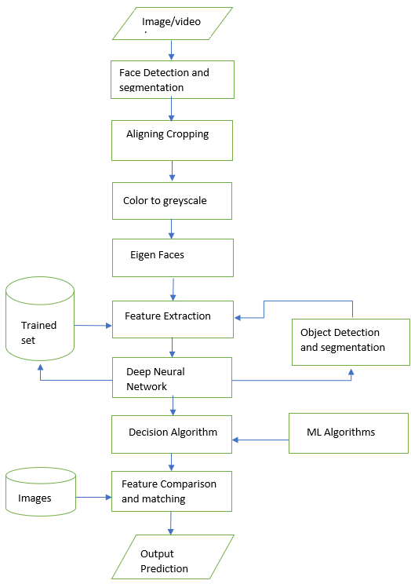
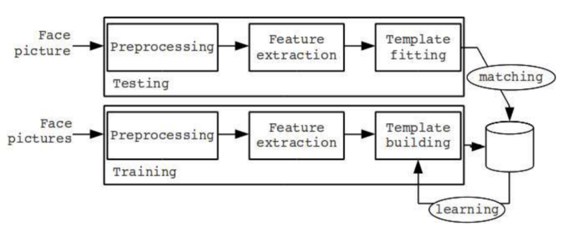
Methodology
The Architecture of Proposed System:
Preprocessing
Training Model
Deep Neural Networks
Prediction of O/P

Slide 5
Modules Identified
Project Modules :
Age & Gender
Facial emotions
Face mask
Social distancing
Drowsiness
Suspicious activities
Python Modules Used:
Python GUI – Tkinter
OpenCV
Keras
Matplotlib
SciPy
TensorFlow
NumPy

Slide 6
Implementation
Step 1: Input Face Images, Videos, stream
Step 2: Preprocessing the Face Images
2.1 Face Detection and Segmentation
2.2 Aligning & Cropping
2.3 Color to Grayscale
2.4 Eigen Faces
2.5 Capturing Features
Step 3: Feature Extraction from Images
3.1 Feature-based /Appearance-based approach
3.2 Object detection and template building (Testing)
3.3 Matching with trained dataset utilizing CPU (GPU, if available)
3.4 improving trained dataset (Training)
Step 4: Classification Methods
4.1 Binary Classification or Multi-label classification
4.2 Decision Algorithm
Step 5: Final Prediction with an output frame

Slide 7
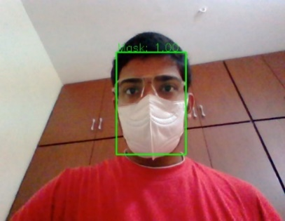
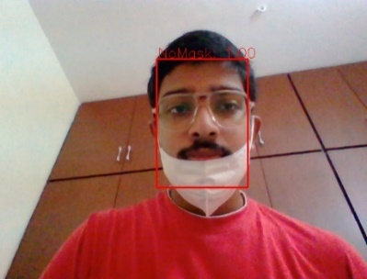
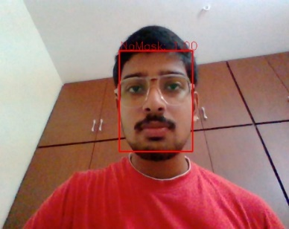
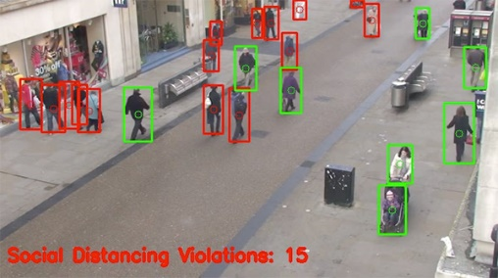
Results
Face Mask Detection =>>
Social Distance Detection =>>

Slide 8
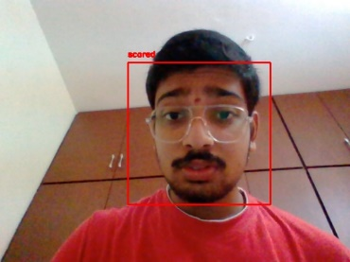
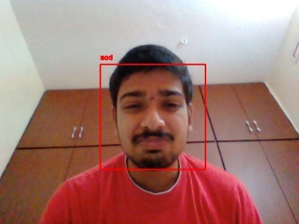
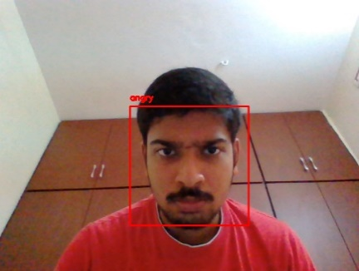
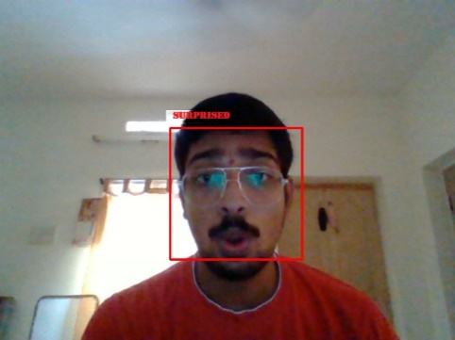
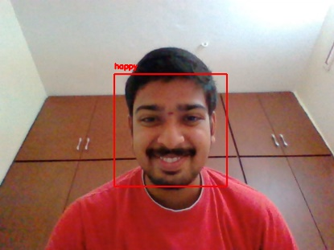
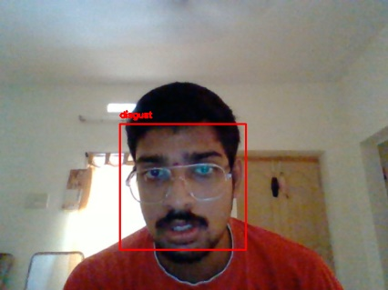
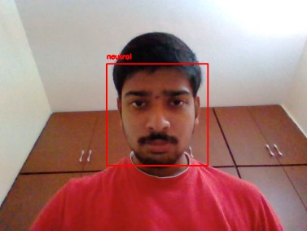
Results
Emotion Detection =>>

Slide 9
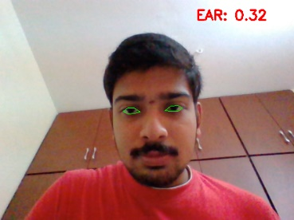
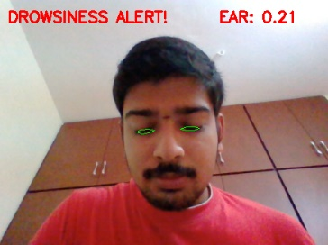
RESULTS
Drowsiness Detection =>>

Slide 10
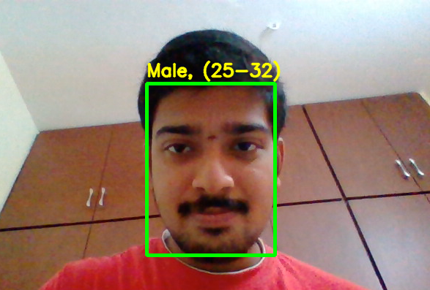
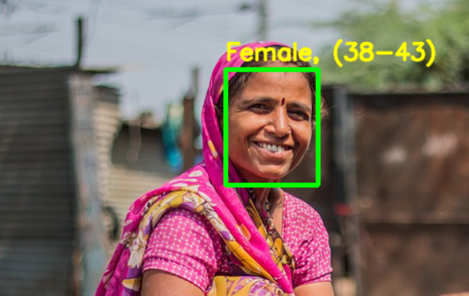
Results
Age & Gender Detection =>>

Slide 11
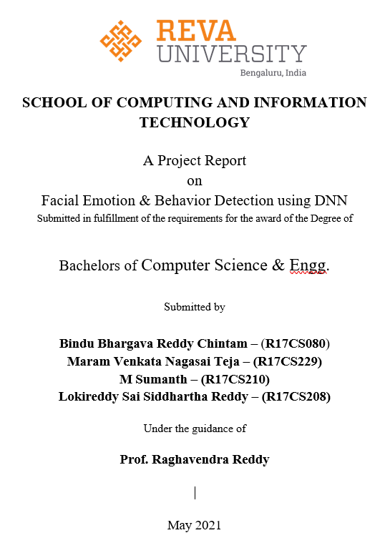
REPORT PREPARATION

Slide 12
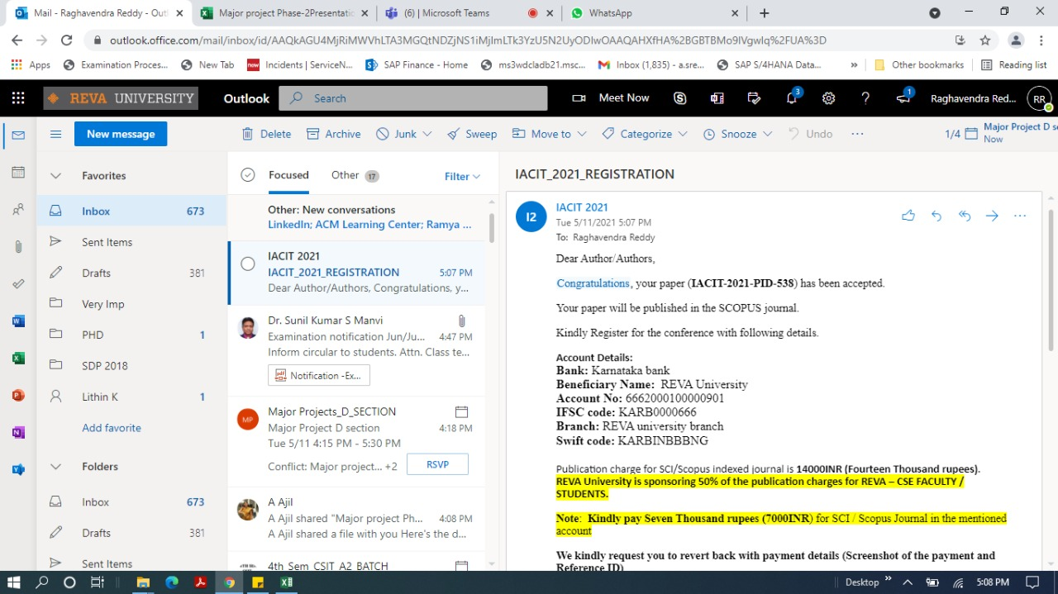
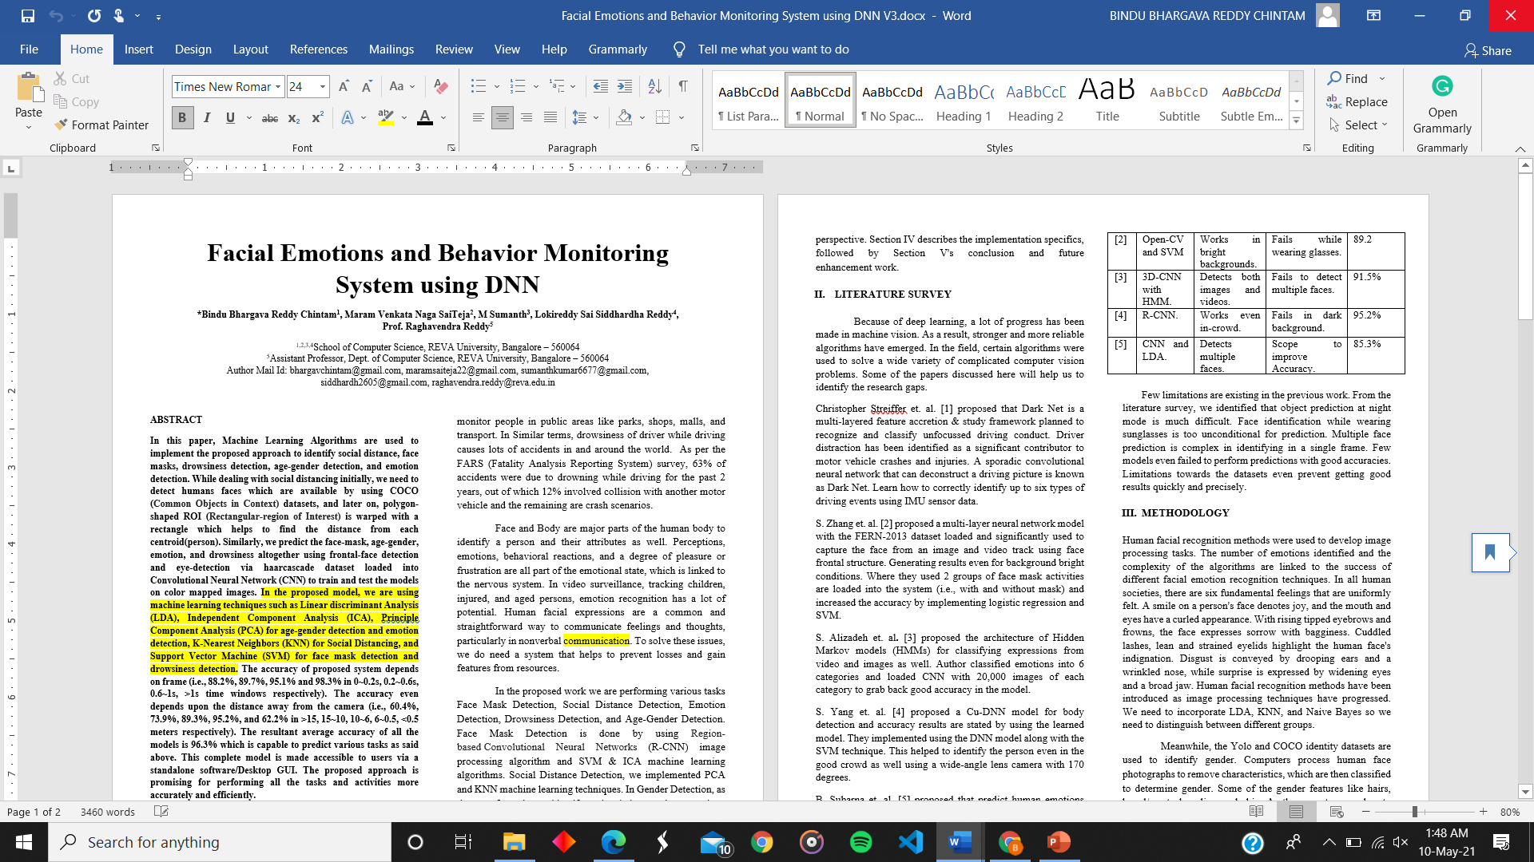
PAPER & PATENT PREPARATION

Slide 13
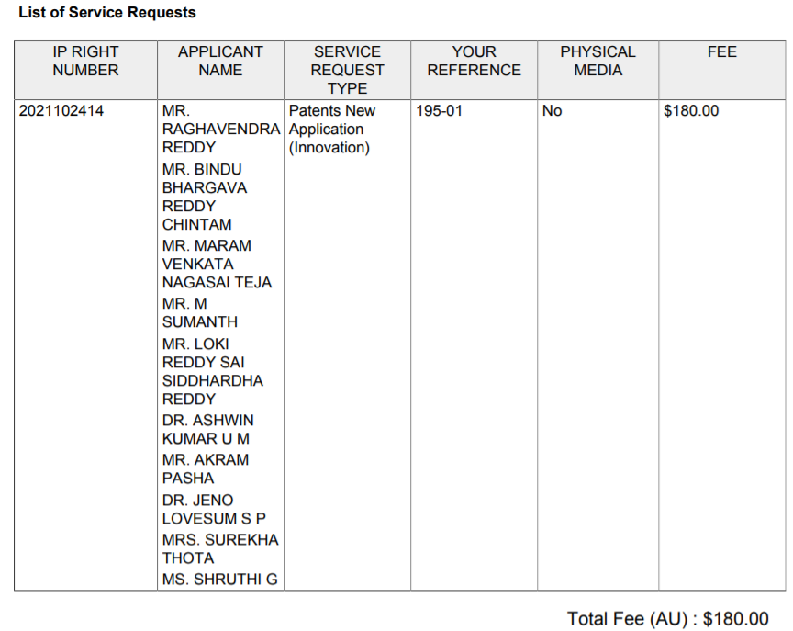
PAPER & PATENT PREPARATION
Title:
A SYSTEM AND METHOD FOR MONITORING FACIAL EMOTIONS AND BEHAVIOR USING DEEP NEURAL NETWORK
Application Number: 2021102414

Slide 14
THANK YOU

